Slide 1
The Role of Abstraction in Non-native Speech Perception
Bozena Pajak and Roger Levy
Presented by:
Adam A. Bramlett

Slide 2
Today’s plan
Discussion of the article
D-Prime
Talk about the design/results
How this paper fits within the larger frameworks
Group activity-
3:01
Notes:
Not convinced by language features
Robust results
Really good questions- some were similar to my questions and some made me think about the study in a new way.
I wont be able to answer all the questions but we will get through some of them.

Slide 3
Starting off thoughts
What do you think generally?
Was the experiment designed thoughtfully?
Does the literature review sufficiently discuss previous relevant work?
Did the data analysis analyse the correct factors?
3:06
Notes:
Not convinced by language features
Robust results
Kaiyings question

Slide 4
The Authors’ Framing
Warped Space
L1 as category filter Trubetzkoy (1939/1969)
acoustically or articulatory most similar
Mapped(perceptually assimilated)
If perceptually close enough
1->2 inhibited
2->2 facilitated
Non-native out performing natives (Bohn & Best, 2012; Hallé et al., 1999)
1- natives performed worse in their native language
2- Non-native outperformed when their native language lacks that phonetic category[w]
But….
Does that extend to something like consonants and vowels?
What is the nature of the categories that can be learned?
The input of language is more rich than previously thought
3:12

Slide 5
Participants
96
“We made sure to recruit participants that considered themselves fluent in their L1”
“The development of speech perception in the first year of life provides a critical foundation for future language learning. Infants undergo profound perceptual reorganization” (Eimas, 1978)
Amount
Self-reported
Data on proficiency
Accentedness
Comprehensibility
3:16
Notes:
Second L1- can take over-

Slide 6
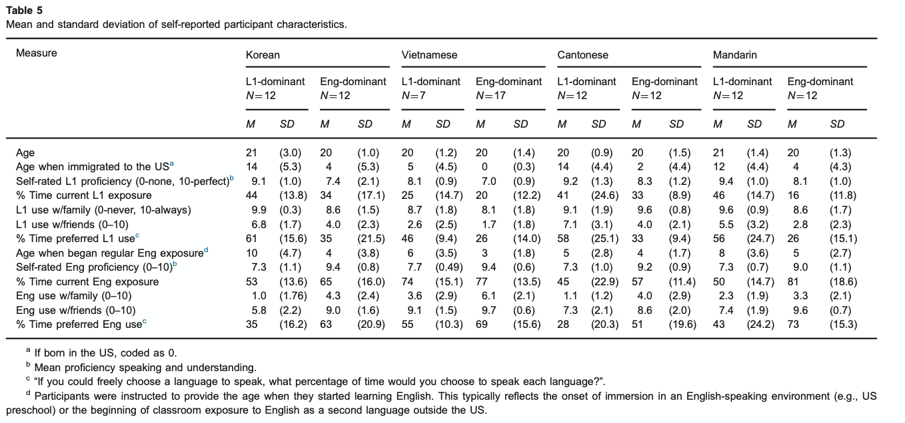
Participants
3:20
Notes:
Noe-Q2, 2. The task seemed targeted/better designed for monolinguals, as they mentioned in the paper. Because they used bilinguals in the study, it’s hard in some places to separate what effects can be attributed to what feature of the language. I would have liked to have either another control or some sort of addition/manipulation to the study that made it better designed for bilinguals to maybe more convincingly account for English bilingual effects or knowledge of another language effects.

Slide 7
Language Characteristics
Languages | Korean | Vietnamese | Cantonese | Mandarin | English
length for vowels | All | 2 sets of vowels | one of the cues used | no | no
length for consonants | Some | Always short | Always short | no | no
Extra length info |  |  |  | secondary cue for tone? | no
Sibilants |  |  |  | yes | no
exposure to L3 |  |  | Mandarin
3:23
Notice implicit Gradience
Notes:
Yi and yin-入声
Yip and yi-same
also secondary cue for tone- three of the lagnuages are tonal and one is not- at least not as dense. I think having a monolingual english speaker would have been interesting

Slide 8
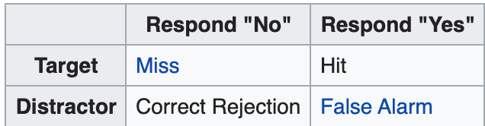
Signal Detection and D-prime
Strategies- Conservative vs liberal
Conservative- no, unless 100% sure signal is present----even though all correct rejection, you will also get some misses
Liberal- yes, unless 100% sure it isn’t there----you will get all the hits, you will also get false alarms
.
Dprime analysis the ucla phonetics lab(fall 2005 but still the best )
http://phonetics.linguistics.ucla.edu/facilities/statistics/dprime.htm
% correct on the different pairs alone is not a very meaningful measure of discrimination. It becomes meaningful when interpreted in terms of the listener's response bias, or tendency to respond "same" or "different". The responses to the same pairs can be used as an indication of response bias
3:28

Slide 9
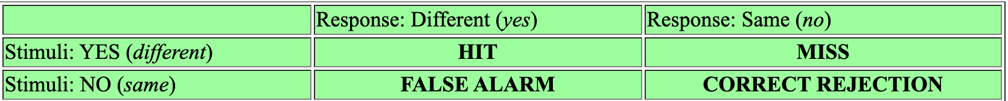
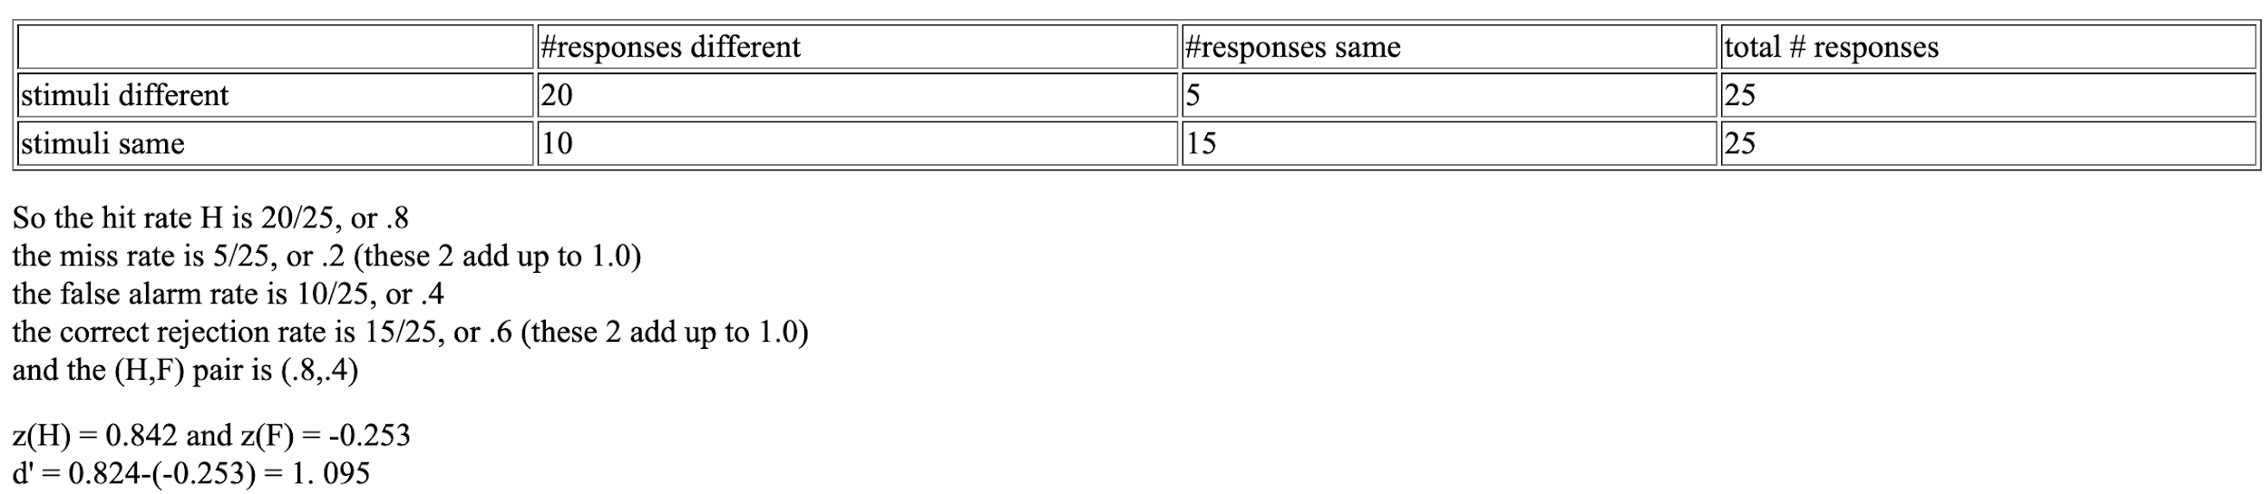
D-Prime (D’)
Account for bias to recover sensitivity (Macmillan and Creelman's 1991 Detection Theory: A User's Guide)
We use H and compare to F- optimal detection is (H,F) (1,0)
But not just H-F
Signal-noise- similarity
http://phonetics.linguistics.ucla.edu/facilities/statistics/dprime.htm (fall 2005 but still the best )
3:33
Notes:
Akari question

Slide 10
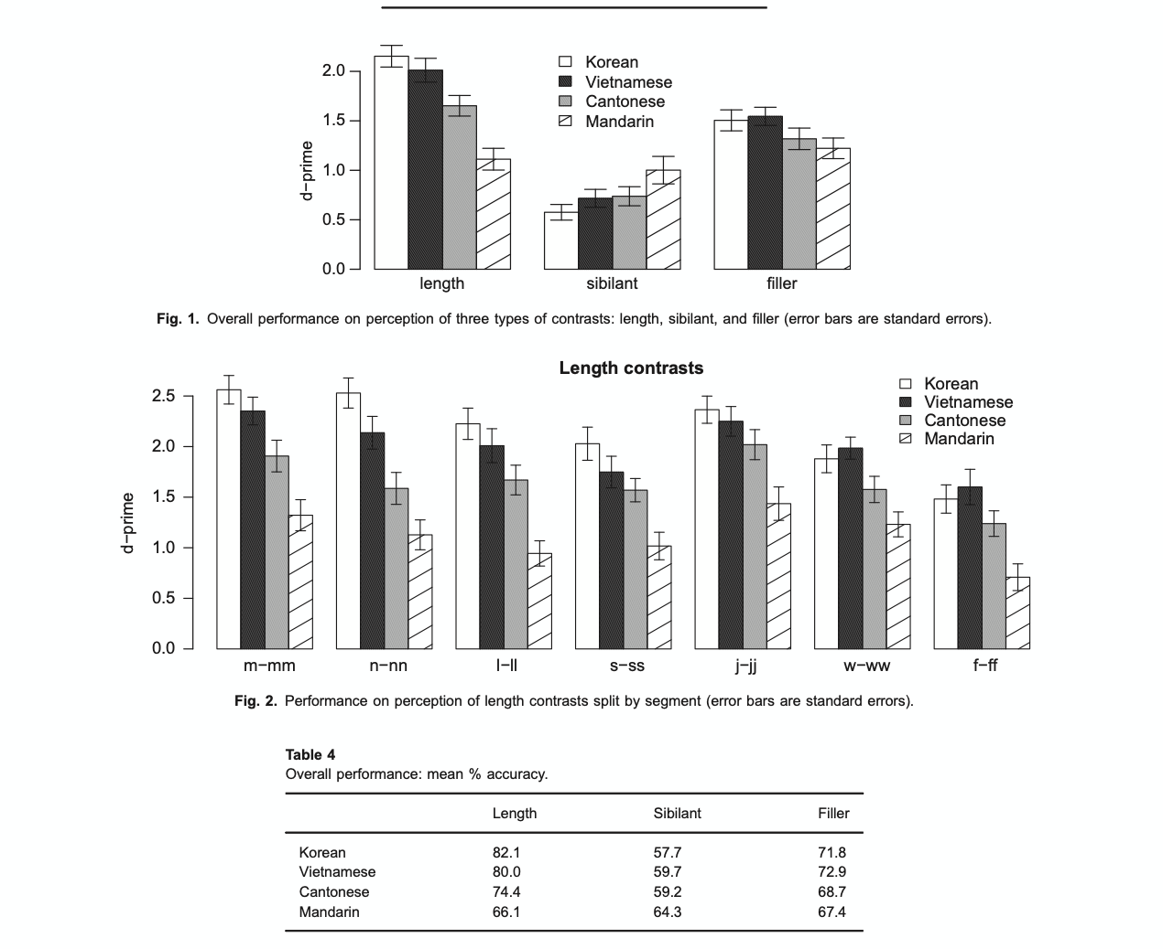
informativity of phonetic dimensions
3:38
Notes:
All of these troubling facts aside. The data is really convincing that they found something even if it wasn’t what they said it was.
better at distinguishing between noise and signal
korean doesn't have Fs sound or Js

Slide 11
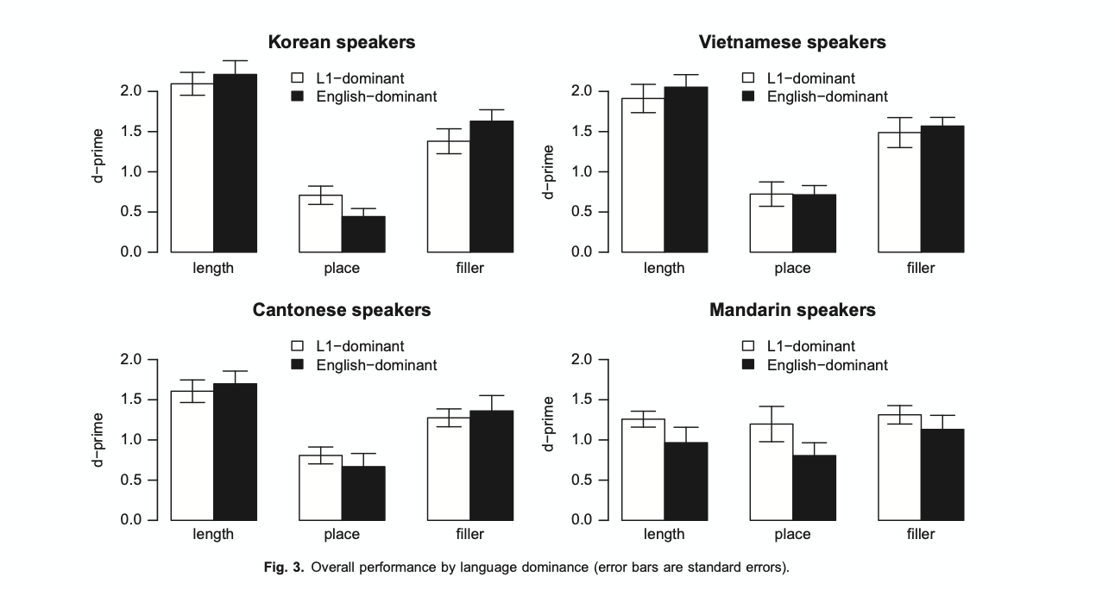
3:40
Notes:
Im not convinced by this. I would be much more convinced if this were looking at proficiency or accentedness.
whichever one was written down first
for self report

Slide 12
Research questions
To what extent is sound perception determined by sensitivity to generalization of sound categories
How far does these categories go?
boundaries-Younggin Q1
3:45
Notes:
Infants learn higher order categories for inducing. They learn the weight of certain cues. The weight is then determined. Their argument then becomes that infants learn the categories generalization and that is their special ability. Refer again to the Vietnamese participants
higher order abstractions

Slide 13
The Trace Model
3:50
Notes:
Its not just chategories of sound but rather higher order generalization. Why stop there? Could it not be category learning in general is a skill?

Slide 14
Exemplar theory
How does this study fit into exemplar theory
Features as skills?
3:55

Slide 15
Production
Processing interphase
This study seems to imply a very direct interphase.
3:57
Notes:
Explicit vs implicit. Even if you tell someone that two categories exist that does not mean that they can perceive it. The question then becomes how the perception changes.

Slide 16
In Progress Ideas
What other features can we imagine-
Activity: What is the nature of these categories?
Think of set of languages that we could test a particular feature or group of features?
example : Mandarin no relative pitch distinctions, Thai and Cantonese do. Thai has more relative pitch distinctions but also uses delayed pitch change.
Could we do something in other domains? Perhaps intonational or morphological? discourse?
4:10

Slide 17
Thanks

Slide 18
Class Questions/Discussion
Can we assume the same phenomenon will be observed in the processing of word/sentence/discourse (broader/higher level, for example)? In other words, morphological or pragmatic features not used to process in L1 will be difficult to perceive/process for the L2 learner? As an L2 learner, I feel more difficult when I say English compared to Japanese because the latter has the same word order and similar vocabulary with the Korean language.
Regarding the characteristics of the Korean language in 2.2., this might be a subjective perspective but I am not sure young Korean native speakers agree with this explanation. If I hear the words mentioned in the article without visual information, I would not be able to identify the meaning well. I think the vowel length distinction is very likely to be prevalent among older people these days, at least in Seoul Korean (I am not sure about other dialects in Korean).
Regarding the 2.4. Procedure, I am wondering if it is okay that the authors did not provide feedback to participants in their practice session. In my opinion, the feedback should be provided because by doing so participants can get used to responding, especially in terms of when and how to respond.
Akari-In their experiment, the participants were asked to judge whether two words were different or same. I thought that this experiment examined whether the participants use the length to distinguish words rather than whether the participants can discriminate two consonants which differ in length. I thought that these two are different abilities, and I wonder whether this experiment could really test what the authors wanted to examine.

Slide 19
Class Questions/Discussion
1. They chose languages that differ in how distinctive length is, but these languages also differ in many other respects. I get that it’s unlikely, but how can they discount the effects of, say, tone on how length is used in the languages? I don’t know much about these four languages, so I would have liked a bit of reassurance from them that discussed other dimensions used in the phonology of a language, or related to the phonology of a language, like tone, and how that can affect or play into length perception.
2. The task seemed targeted/better designed for monolinguals, as they mentioned in the paper. Because they used bilinguals in the study, it’s hard in some places to separate what effects can be attributed to what feature of the language. I would have liked to have either another control or some sort of addition/manipulation to the study that made it better designed for bilinguals to maybe more convincingly account for English bilingual effects or knowledge of another language effects.
3. How does the model modification proposed in this paper fit into the model proposed by Pierrehumbert and the TRACE model?
4.I think this research result is more consistent with my intuition about second- language learning and non-native languages. My own experience suggests that non-native sounds will not directly be mapped onto my mother language perception, especially after I learned the language seriously. Instead, another domain/mode of sound perception will be open and I feel I can perceive the non-native sounds if I change the mode into non-native languages. However, I wonder if this result differs according to different speakers. This means that some speakers still map the non-native sounds into the native sounds, but some don’t.

Slide 20
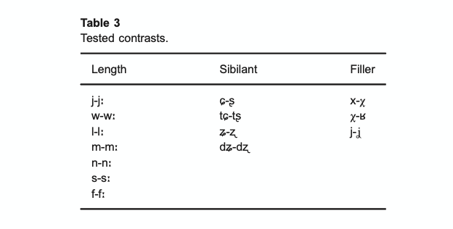
Extra Slides

